Slide 1

Houston Demographics, Assets, & Challenges
Ruth N. López Turley, PhD
Professor of Sociology
Director, Kinder Institute for Urban Research
Rice University

Slide 2

40,000 non-profits in Houston metro area
Very few have research capacity

Slide 3

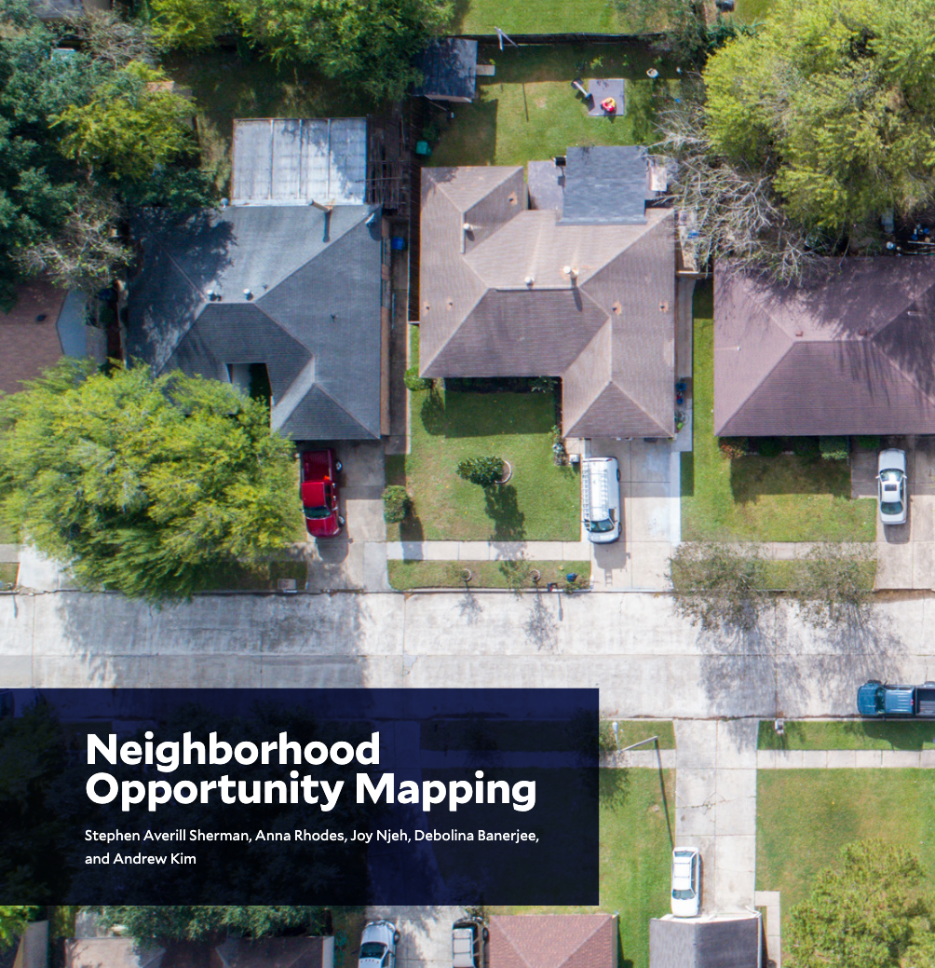
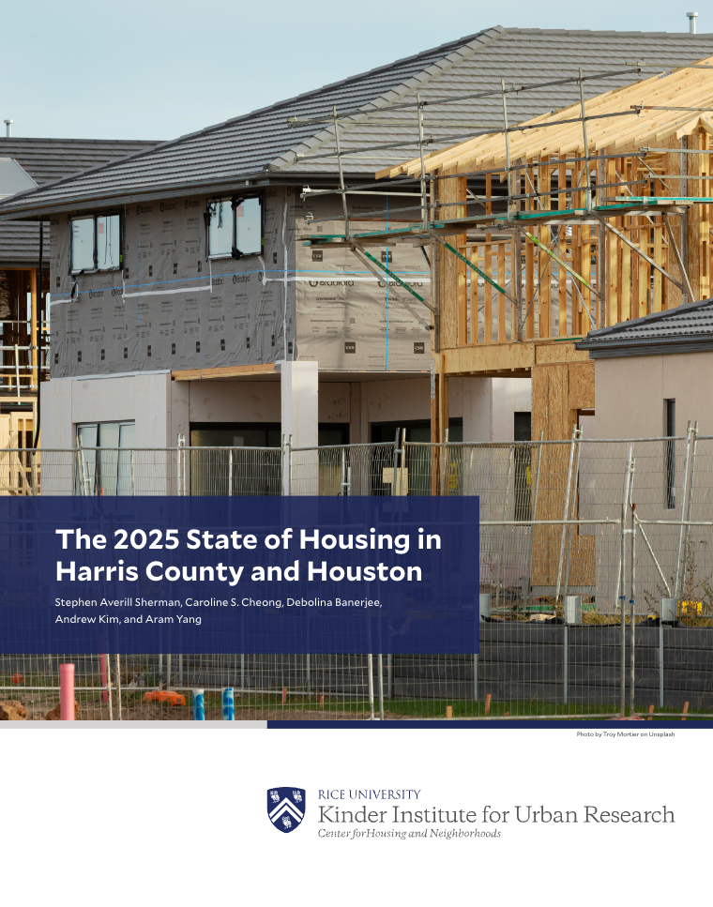

Research Reports at kinder.rice.edu
Research as a Public Good
Data Visualization Tool at datahouston.org
Datasets at kinderudp.org

Slide 4


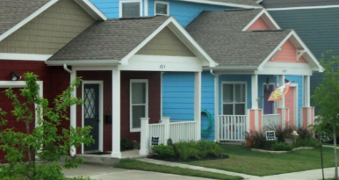


Kinder Institute Research Centers
Houston Population Research Center
Houston Education Research Consortium
Center for Housing & Neighborhoods
Center for Economic Mobility
Center for Community & Public Health

Slide 5
Racial/Ethnic Composition of Harris County
Whites
7
33
.08
16
10
20
18
18
18
20
6
74
63
54
42
33
Source: U.S. Census Bureau, 1960-2020
Notes:
Source: US Census

Slide 6
Harris County population by age and ethnicity
Source: U.S. Census, American Community Survey (2015-2019)
Notes:
Source: ACS, 2015-2019

Slide 7
Eight most diverse large metro areas
PERCENT OF POPULATION
Source: U.S. Census Redistricting Data 2020.
Notes:
Source: US Census 2020

Slide 8
Population change in 10 largest metros
Note: Due to data-collection issues during the first year of the COVID-19 pandemic, 1-year estimates have not been produced for 2020 and therefore are not included in the figure.
Source: American Community Survey 1-year estimates, U.S. Census Bureau, Table DP05, 2010 to 2023.

Slide 9
Population change within Houston area
Note: Population change in Harris County excludes population numbers from the city of Houston. Due to data-collection issues during the first year of the COVID-19 pandemic, 1-year estimates have not been produced for 2020 and therefore are not included in the figure. Source: American Community Survey 1-year estimates, U.S. Census Bureau, Table DP05, 2010 to 2023.

Slide 10
Survey respondents
(Fort Bend, Harris, & Montgomery Counties)
Income
<$25k | 26%
$25k-$49,999 | 23%
$50k-$99,999 | 16%
$100k+ | 35%
Race/Ethnicity
Asian | 11%
Black | 18%
Hispanic | 38%
White | 30%
Other | 3%
Age
18-29 | 28%
30-49 | 37%
50-64 | 20%
65+ | 14%
Education
HS or less | 41%
Some college | 26%
Bachelor’s | 17%
Grad degree | 15%
Political Ideology
Extremely conservative | 4%
Conservative | 16%
Slightly conservative | 12%
Moderate | 37%
Slightly liberal | 11%
Liberal | 15%
Extremely Liberal | 4%

Slide 11



What's the best thing about living in the Houston area?
Diversity
Economy/
opportunity
Activities/entertainment/
goods/services

Slide 12
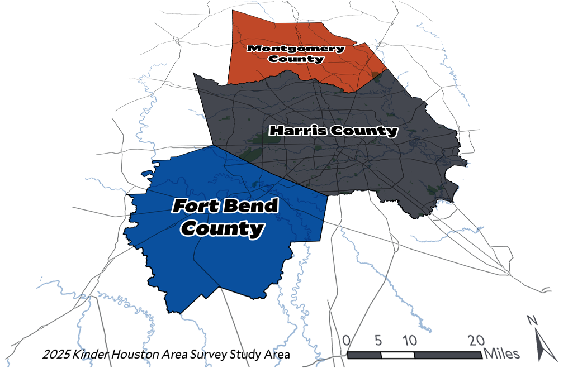
Montgomery County
1 in 8
born outside the US
Fort Bend County
1 in 4
born outside the US
Harris County
1 in 4
born outside the US

Slide 13
Do immigrants contribute more than they take?
Immigrants contribute more
Undocumented immigrants contribute more
Note: Survey respondents were asked the following questions: Do immigrants (regardless of legal status) generally take more or contribute more to the American economy? Do undocumented immigrants generally take more or contribute more to the American economy?

Slide 14
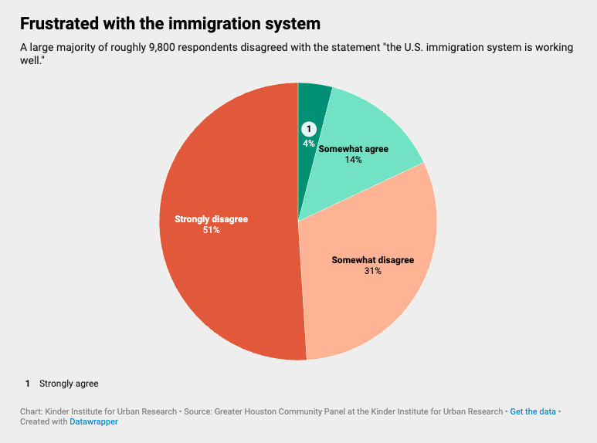

Slide 15
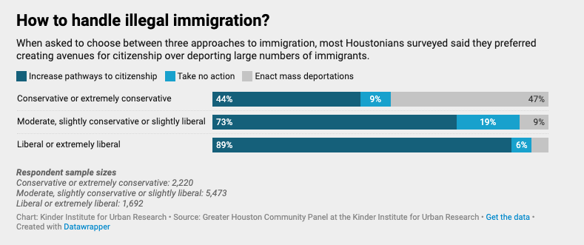
Mass deportation isn’t popular
Notes:
Overall, 70% supported increasing pathways

Slide 16
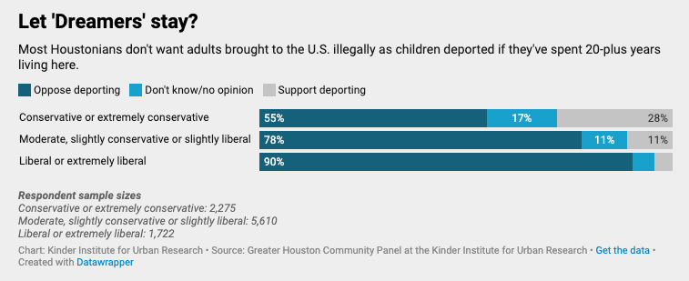
Strong backing for ‘Dreamers’
Notes:
Overall, 75% opposed deporting adults who were brought as children and have now lived here for 20+ years

Slide 17
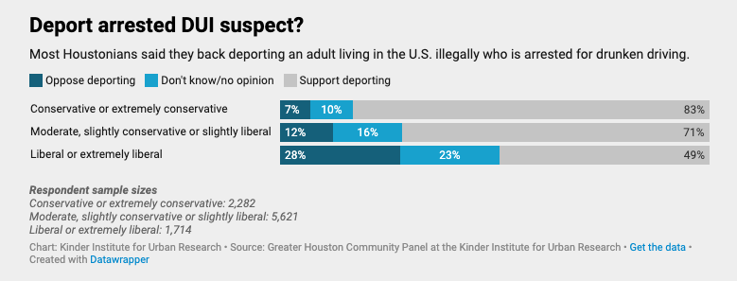
Little patience for those accused of crimes
Notes:
Overall, 70% supported deportation of someone arrested for drunk driving

Slide 18
Perceptions across income levels

Slide 19
How would you handle a $400 emergency?
Note: Details may not sum to total due to rounding.

Slide 20
Percent of residents who want government action
Everyone who wants to work can find a job
Reduce economic inequality between rich and poor
Note: Analysis of data from 2010 to 2024 is limited to Harris County residents only. In 2025, Harris County, Fort Bend County, and Montgomery County residents are included in analysis.

Slide 21
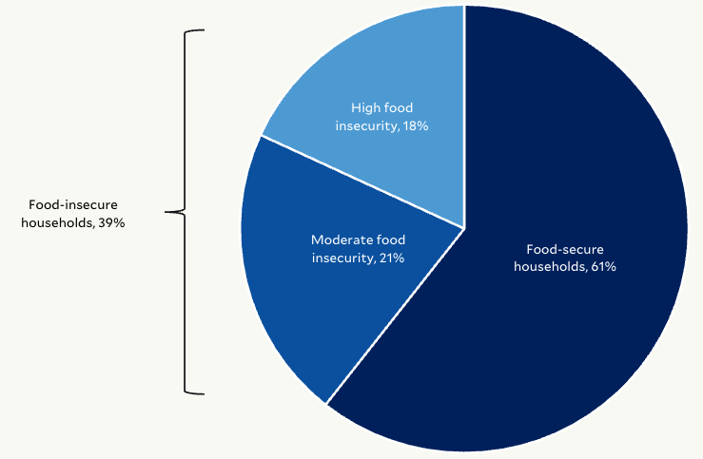
Food Insecurity among Households, 2024
Notes:
We found a MUCH higher rate of 39% in Harris County.
“The food we bought just didn’t last, and we didn’t have money to get more.”
“We couldn’t afford to eat balanced meals.”
“We couldn’t feed the children a balanced meal because we couldn’t afford that.”
”In the last 12 months, did you or another adult in your household ever cut the size of your meal or skip meals because there wasn’t enough money for food?”
”In the last 12 months, was any child in the household ever hungry but you just couldn’t afford more food?”
“In the last 12 months, did you ever eat less than you felt you should because there wasn’t enough money for food?”
“In the last 12 months, were you ever hungry but didn’t eat because there wasn’t enough money for food?”

Slide 22
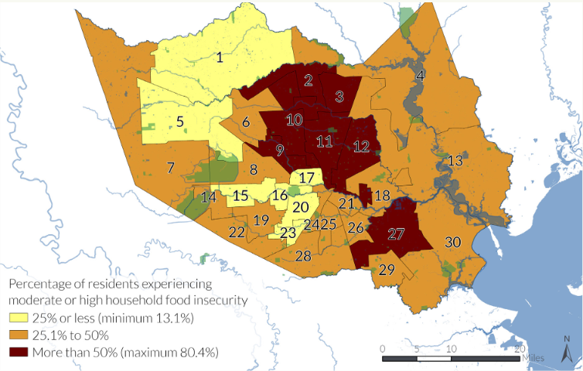
Household Food Insecurity by Neighborhood Area
Notes:
Furthermore, we were able to estimate food insecurity rates by neighborhood area so that we could inform our community partners who are aiming to address food insecurity.

Slide 23
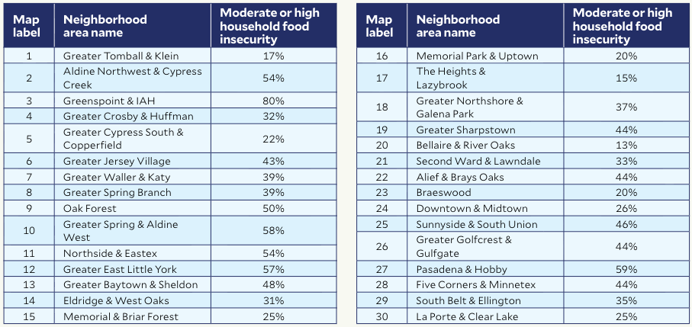
Household Food Insecurity by Neighborhood Area
Notes:
As you can see, there is a lot of variation by neighborhood area, where some areas have very little food insecurity, while others have very high food insecurity, as high as 80%.
The area with the highest rate of food insecurity was Greenspoint & IAH, but there were several others with more than 50% of residents reporting food insecurity.
This is an example of how collecting our own data can improve upon available estimates and inform agencies that need to know where to target their services.
But, as I mentioned earlier, we’re not only interested in meeting needs, we’re interested in eliminating them.

Slide 24

Economic Mobility Annual Report Coming Spring 2026!
Notes:
I’m super excited to announce that, starting in 2026, the Kinder Institute will begin releasing an annual economic mobility report for our region.
We will monitor our economic mobility – the ease with which people can move up in economic status.
For example, if someone happens to be born into a family in the bottom 10% of the economic distribution, what are their chances of moving up to the median or higher?
These chances vary a lot by geographic region, even by neighborhood.
High mobility neighborhoods tend to share characteristics such as
Lower poverty rates
More stable family structure
Better school quality
Greater social capital
The new annual report will provide a baseline measure of predictors of economic mobility in our region and monitor them over time.

