Slide 1
Advancing Opportunity
Steve Kean
President and CEO

Slide 2
Houston is Winning
We are Growing
We are Global
We have Strong Demographics
We are Aligned

Slide 3
Houston is the Youngest Major U.S. Metro % Population Under 18, 10 Most Populous Metros
Metro | % Under Age 18
Houston | 25.7%
Dallas-Fort Worth | 24.7
Atlanta | 23.2
Washington, DC | 22.5
Phoenix | 22.0
Chicago | 21.7
Philadelphia | 21.2
New York | 20.9
Los Angeles | 20.3
Miami | 19.8
Source: U.S. Census Bureau, 2023 American Community Survey
Notes:
CB confirmed no need to update as of 04/02/2025. ACS 2023 is the most up-to-date data.

Slide 4
Houston is the Youngest Major U.S. Metro Change, ’18 – ’23 Under 18 Population
 | Under 18 Pop. |  | Change, ’18 – ’23
Metro Area | ’18 | ’23 | # | %
Houston | 1,856,855 | 1,926,640 | 69,785 | 3.8%
Dallas-Ft Worth | 1,954,835 | 2,003,841 | 49,006 | 2.5%
Atlanta | 1,450,740 | 1,465,032 | 14,292 | 1.0%
Philadelphia | 1,320,923 | 1,321,226 | 303 | 0.0%
Washington | 1,434,315 | 1,417,951 | -16,364 | -1.1%
Miami | 1,254,388 | 1,221,810 | -32,578 | -2.6%
Phoenix | 1,153,928 | 1,117,257 | -36,671 | -3.2%
New York | 4,289,434 | 4,070,993 | -218,441 | -5.1%
Chicago | 2,159,045 | 2,007,512 | -151,533 | -7.0%
Los Angeles | 2,887,679 | 2,598,650 | -289,029 | -10.0%
Source: U.S. Census Bureau, 2023 American Community Survey
Notes:
CR Updated 4/3 with 2023 data

Slide 5
Houston is the Youngest Major U.S. Metro
Population Pyramid, U.S. vs Metro Houston
U.S. Exceeds Houston
Houston Exceeds U.S.
Source: U.S. Census Bureau American Community Survey ‘23

Slide 6

Houstonians Attitudes Towards Immigrants
6
Notes:
CB Update 04/03/2025 Changed chart to a simpler format that more closely matches other charts in the presentation

Slide 7
Houstonians Are Optimistic
Attitudes Toward the Future
7

Slide 8
Houston’s Rapidly Growing Population
Ten Year Change, 20 Most Populous Metros, ’14-’24
Metro | % Change ‘14-‘24 | Metro | % Change ‘14-‘24
Orlando | 26.7 | Riverside | 6.8
Houston | 20.1 | Washington | 6.7
Dallas | 20.0 | Boston | 6.2
Tampa | 17.5 | Philadelphia | 4.6
Phoenix | 15.5 | Detroit | 2.4
Atlanta | 14.2 | San Francisco | 1.2
Seattle | 12.9 | San Diego | 1.1
Denver | 10.8 | New York | -0.8
Miami | 8.9 | Chicago | -1.5
Minneapolis | 7.5 | Los Angeles | -2.5
Source: U.S. Census Bureau
Notes:
CR Update 4/3 US Census Population Estimates (24) and ACS (14)

Slide 9
Houston’s Rapidly Growing Population
2024 Residents Added, 20 Most Populous U.S. Metros
Metro | Residents Added | Metro | Residents Added
New York | 213,403 | Boston | 58,251
Houston | 198,171 | Tampa | 50,482
Dallas | 177,922 | Philadelphia | 49,520
Miami | 123,471 | Los Angeles | 41,214
Washington | 90,608 | Riverside | 39,860
Phoenix | 84,938 | San Francisco | 39,041
Orlando | 75,969 | Minneapolis | 35,476
Atlanta | 75,134 | Denver | 31,748
Chicago | 70,762 | Detroit | 30,988
Seattle | 66,666 | San Diego | 12,909
Source: U.S. Census Bureau

Slide 10
Creating Jobs and Opportunity
Jobs Added Last Five Years, 20 Most Populous U.S. Metros (2019-2024)
Metro | Jobs Added | Metro | Jobs Added
Dallas | 467,000 | Denver | 86,400
Houston | 274,700 | Washington | 74,500
New York | 261,800 | San Diego | 54,200
Atlanta | 231,500 | Seattle | 43,600
Phoenix | 230,000 | Chicago | 24,300
Miami | 226,800 | Los Angeles | 16,000
Orlando | 167,400 | Detroit | 5,600
Tampa | 151,700 | Minneapolis | -3,800
Riverside | 134,000 | Boston | -30,800
Philadelphia | 116,500 | San Francisco | -73,300
Source: U.S. Census Bureau

Slide 11
Named Storms and Metro Houston Employment 1980-2025
Nicholas
Beryl
Imelda
Harvey
Beta
Issac
Ike
Allison
Grace
Josephine
Fay
Jerry
Dean
Rosa
Danielle
Bonnie
Chantal
Alicia
11

Slide 12
Houston is a Global City
Top Export Metro
Rank | Metro | $ Billions
1 | Houston | 180.9
2 | New York | 99.4
3 | Los Angeles | 59.0
4 | Chicago | 57.5
5 | Dallas-Fort Worth | 51.0
6 | Miami | 46.9
7 | New Orleans | 43.3
8 | El Paso | 41.3
9 | Detroit | 40.6
10 | Cincinnati | 38.8
Metro Houston
Foreign-Born Population
Metro Houston
Foreign-Born Labor Force
25%
31%
Home to 86 Consulate Offices and Honorary Consuls
12
Source: U.S. Census Bureau; U.S. Exports by Metropolitan Area 2024
Notes:
CB updated 04/03/2025. Press clippings are unchanged. Foreign born calculations were based on most recent data (ACS 2023 1-year estimates) and are not updated. New consulate number used matching upcoming Global Houston ‘25, with language tweaked for accuracy. Ranking of Houston as no.3 largest consular corps removed because could not locate an up-to-date source.

Slide 13
U.S. & Metro Houston Inflation Rates
Source: U.S. Bureau of Labor Statistics CPI-U Data

Slide 14
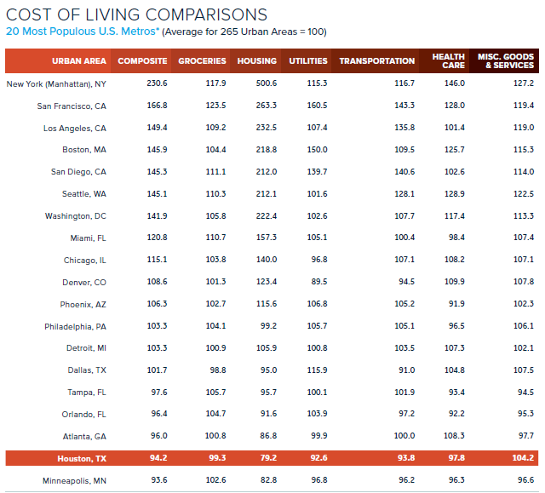
Houston’s Low Cost of Living
Houston is the 2nd most affordable major U.S. metro
Houston Facts, Page 42

Slide 15
Main Reason for Moving to Houston
Source: 44th Kinder Houston Area Survey
15

Slide 16
America’s Hottest Cities – 5-Year Population Growth Rate
20 Most Populous U.S. Metros
Rank | Metro | Growth (%) | Rank | Metro | Growth (%)
1 | Orlando | 9.1 | 11 | Washington | 2.5
2 | Dallas | 8.5 | 12 | Minneapolis | 1.8
3 | Houston | 8.3 | 13 | Boston | 1.6
4 | Tampa | 7.3 | 14 | Philadelphia | 1.3
5 | Phoenix | 6.5 | 15 | Detroit | 0.2
6 | Miami | 4.9 | 16 | San Diego | 0.0
7 | Atlanta | 4.7 | 17 | Chicago | -0.5
8 | Seattle | 3.1 | 18 | New York | -0.7
9 | Riverside | 3.0 | 19 | Los Angeles | -2.1
10 | Denver | 2.9 | 20 | San Francisco | -2.3
Note: Represents population change between April ‘20 and July ‘24
Source: Partnership Analysis of U.S. Census Bureau Data

Slide 17
America’s Hottest Cities – 3-Year GDP Growth Rate
20 Most Populous U.S. Metros
Rank | Metro | Growth (%) | Rank | Metro | Growth (%)
1 | Houston | 25.1 | 11 | Minneapolis | 16.3
2 | Miami | 22.8 | 12 | Chicago | 16.1
3 | Tampa Bay | 22.7 | 13 | Philadelphia | 15.7
4 | Dallas | 21.6 | 14 | Washington | 15.5
5 | Phoenix | 20.8 | 15 | Baltimore | 15.4
6 | Denver | 19.8 | 16 | San Diego | 15.4
7 | Atlanta | 18.0 | 17 | Los Angeles | 14.0
8 | Detroit | 17.5 | 18 | Boston | 13.6
9 | Seattle | 17.2 | 19 | New York | 13.5
10 | Riverside | 16.7 | 20 | San Francisco | 10.8
Source: Partnership Analysis of U.S. Bureau of Economic Analysis Data, 2021-23

Slide 18
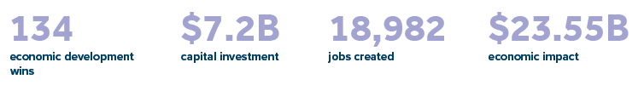









Advancing Opportunity Recent Economic Development Wins
Partnership Project Wins Since 2021
Innovation Ecosystem Growth
1,000 venture-back start-ups
$10 billion+ VC dollars raised since 2021
Home to Five Unicorns ($1 billion+ valuation):
HighRadius, Axiom Space, Solugen,
Cart.com, Fervo Energy.
Fortune 500 Headquarters
#3 in U.S. with 26 Companies
New York (62), Chicago (30)
Ahead of DFW (21)
Recruited Here Since 2021
Notable Wins
Project Savannah
Pre-Announcement
Pharma Manufacturing
$5.9 billion investment
600 jobs, 2,000 construction jobs
18

Slide 19
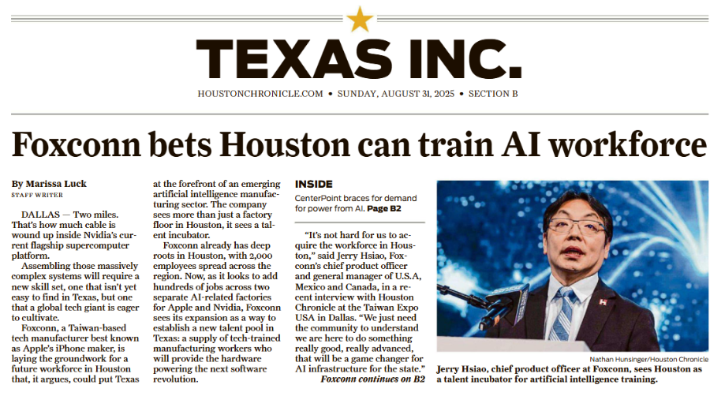
19

Slide 20
Houston’s Sector Diversification Metro Houston Job Growth by Sector (Dec ‘04 – Dec ‘24)
Sector | Jobs | Sector | Jobs
Health Care | 171,600 | Manufacturing | 33,400
Restaurants & Bars | 135,500 | Misc. Business | 30,800
Prof, Sci & Tech Services | 130,800 | Private Education Services | 30,400
Retail | 76,800 | Finance & Insurance | 27,000
Transport & Warehousing | 75,100 | Real Estate & Rentals | 16,000
Admin Supp & Waste Mgmt | 70,400 | Arts & Recreation | 14,900
Construction | 67,900 | Oil & Gas Extraction | 9,800
Public Education | 65,600 | Utilities | 9,100
Wholesale | 58,000 | Hotels | 8,100
Government | 53,400 | Information | -6,600
Other Services | 41,600 | Total | 1,119,600
Source: Partnership Analysis of Texas Workforce Commission CES Data

Slide 21
Houston’s Sector Diversification Oil & Gas Extraction Share of Metro Houston GDP
Source: Partnership Analysis of U.S. Bureau of Economic Analysis Data

Slide 22
2025 YTD Project Pipeline GHP Economic Development – 121 Projects
Project Pipeline: 121 projects; ~38,700 jobs; ~$38 B Capex

Slide 23



Slide 24













Industries of Focus
Energy
Life Sciences
Aerospace & Aviation
Advanced Manufacturing
Digital Tech & Innovation
24

Slide 25
Special Initiatives
Houston Energy Transition Initiative
Talent & Economic Mobility
Regional Resilience
25

Slide 26

Scan for more information
26

